Slide 1

PowerTalk
A new era of Market Intelligence
November 2024

Slide 2

What is PowerTalk??
It is an AI Agent that is connected to huge data sources can:
Provides insights about the energy markets for short and long term.
Answer questions about past present, and future conditions based on history and our forecast tools.
Run cases in our apps on-demand for users.

Slide 3
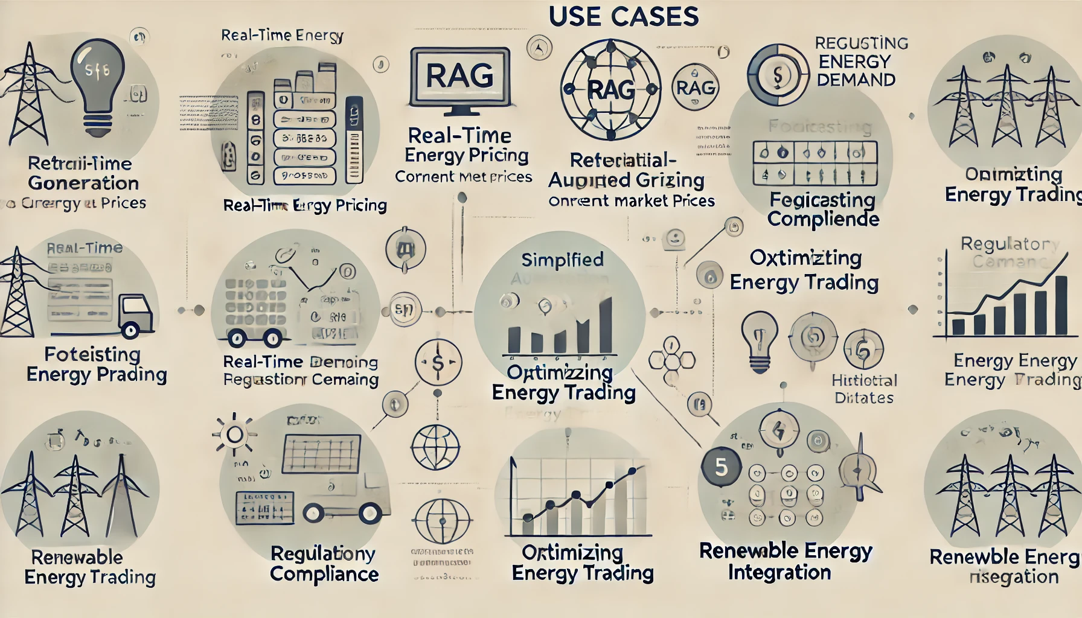
Use Cases Examples
“Hey PowerTalk, could you tell me what was the maximum LMP of PJM in 2023?”
“Hey PowerTalk please run a congestion IQ case for tomorrow, considering a high demand scenario for ERCOT? And tell me about North hub LMPs”
“Could you tell me what to expect in the energy market for the next 10 years?”
“Could you tell me what was the range of bids for Bat Cave power plant last month?”

